Slide 1

Climate data quality control – the issues and potential for automation
Blair Trewin, Bureau of Meteorology

Slide 2
Why do we need data quality control?
Observations are made using real instruments and real observers! Some sources of error:
Observer error (e.g. misreading by 5 or 10 degrees)
Data processing errors
Instrument faults
Data spikes (e.g. from electrical interference)
External interference
Different elements, and different types of instruments (manual, automatic), have different potential error modes.

Slide 3
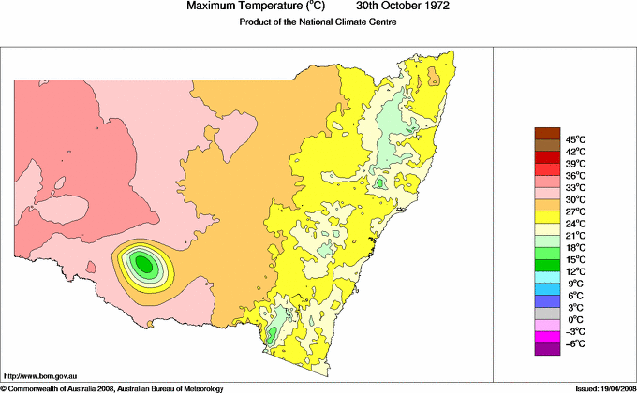
An example of a suspect observation
12.5°C maximum at Hay
All other sites within 200km between 28.9 and 33.5
3pm temperature was 29.5
Minimum (which was also 12.5) probably incorrectly reported as maximum

Slide 4
How do we define 'automatic' and 'manual' QC?
Manual QC typically has two elements – an automatic step to identify potentially suspect data, then a manual process to decide whether to accept/reject the flagged data
Automatic QC has the automated step only
Manual QC typically gives better results (although limited objective evaluation of this); requires judgement so not fully reproducible
Manual QC is labour-intensive
Automatic QC is the only feasible option for very large data sets (e.g. global) or high time-resolution (e.g. 1-minute)

Slide 5
Types of quality control checks
Range/limit checks – some of these are hard (wind direction must be between 0 and 360 degrees), some are soft (e.g. highest value on record at a station)
Internal consistency – comparing two or more types of data or data points (e.g. checks for excessively rapid change; comparing maximum temperature with highest hourly temperature)
Spatial intercomparison
Historically, QC was mostly limited to basic internal consistency and range checks – spatial intercomparison only became possible with modern computer systems

Slide 6
How might one do a spatial check?
Absolute difference with other sites (e.g. 4 degrees higher than all other neighbours)
Interpolate values from other sites (weighted by distance and/or correlation)
Full cross-validation (where a gridded analysis is run with the test value withheld, then the test value can be compared with that)

Slide 7
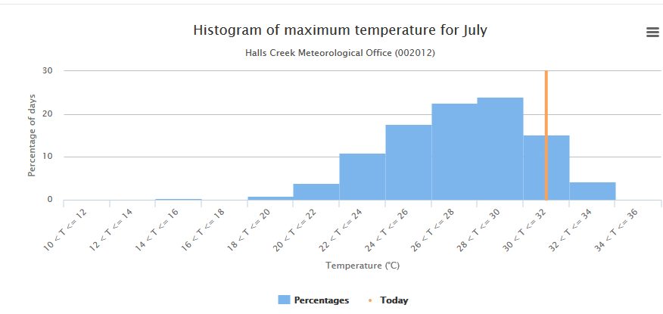
Distributions are often skewed, even for unbounded elements
Maximum temperature negatively skewed in arid areas, but positively on southern coasts in warmer months
Valid z-scores above +9 and below -6 have occurred

Slide 8
For any tests with 'soft limits', thresholds need to be set
A high threshold will see some errors missed; a low threshold may see genuine data (especially genuine extremes) rejected
Critical to determining thresholds is to establish 'normal' levels of variation
This implies that errors which are smaller than the 'normal' noise level may not be detectable

Slide 9
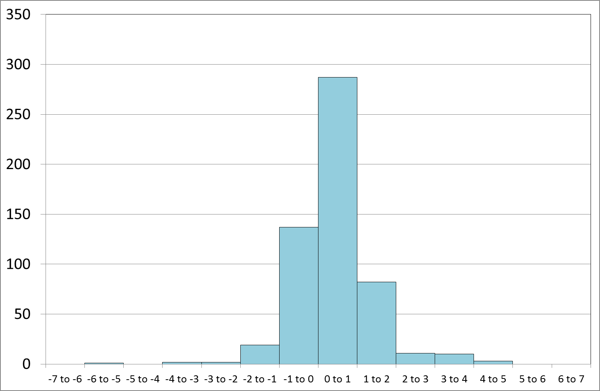
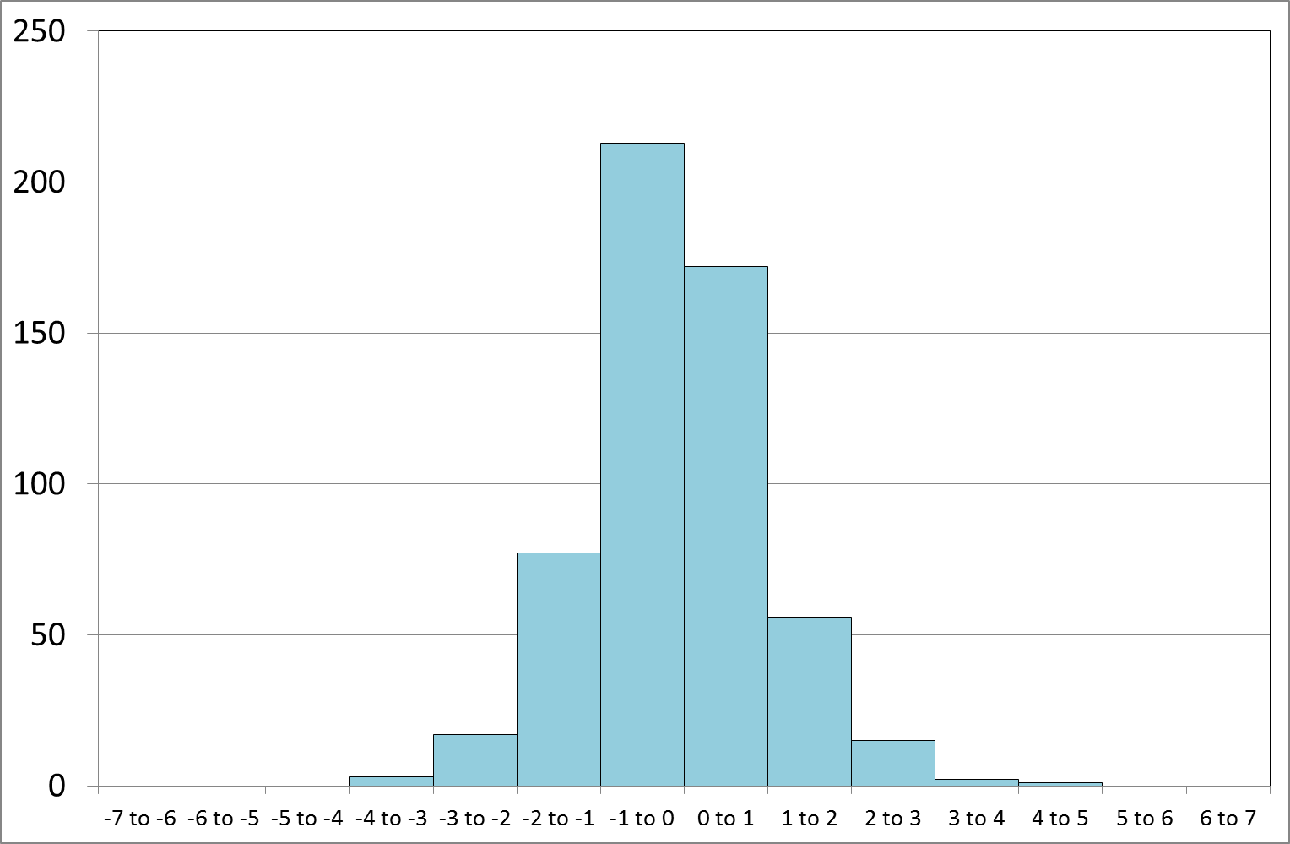
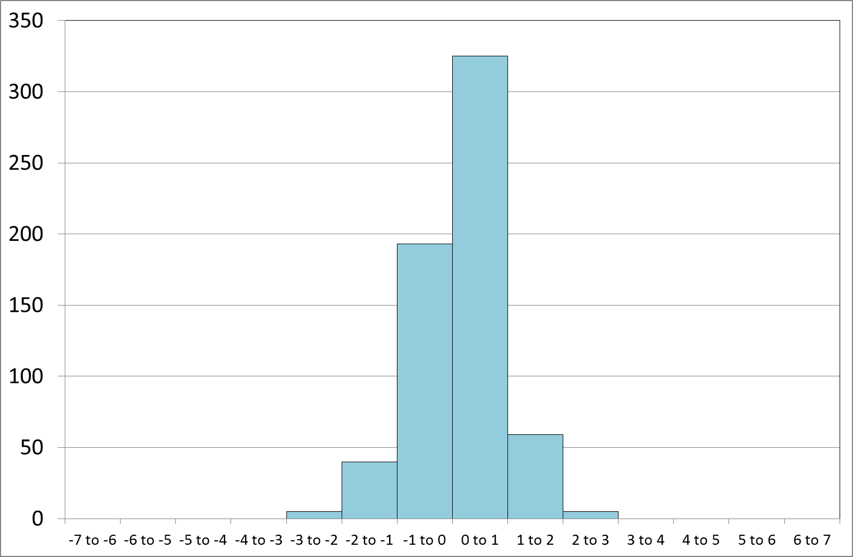
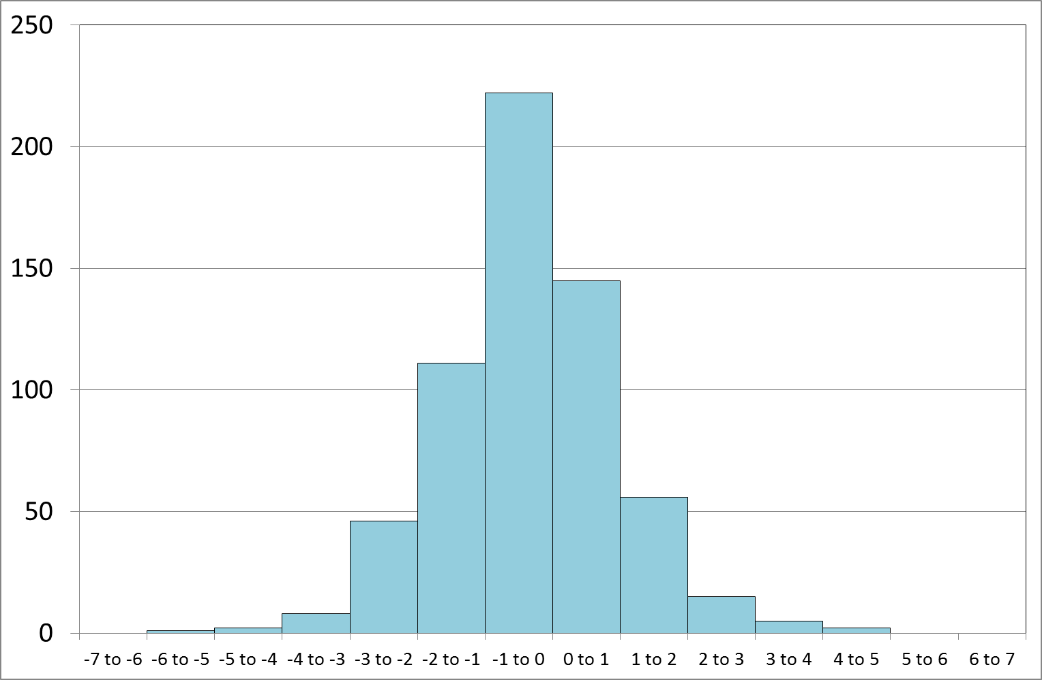
Typical patterns of variation – temperature differences – Swan Hill and Kerang
Feb max
Feb min
Jul max
Jul min

Slide 10
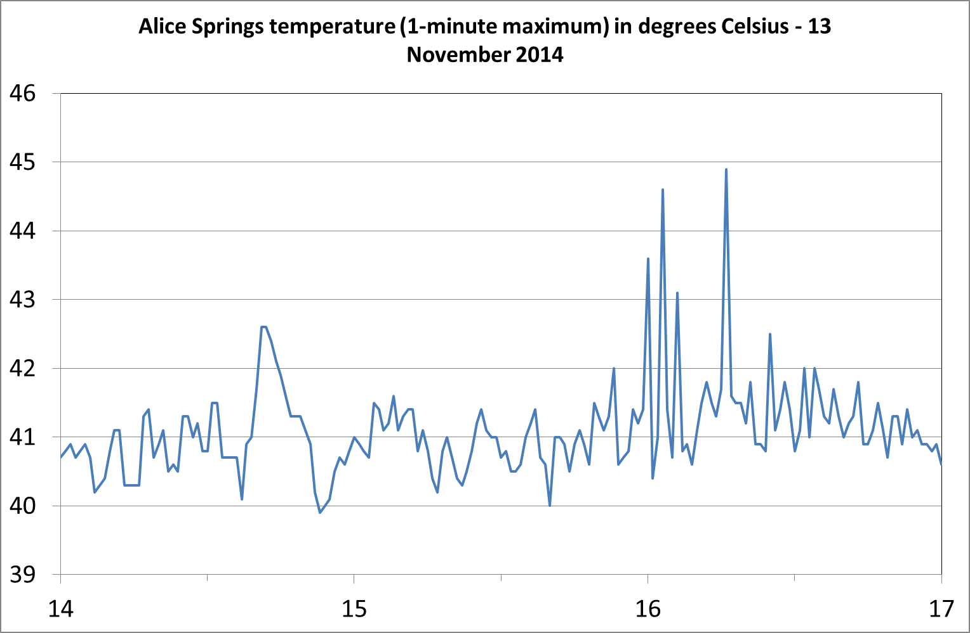
Some unusual things happen in the real world
Numerous spikes of 2-4°C within 1 minute

Slide 11
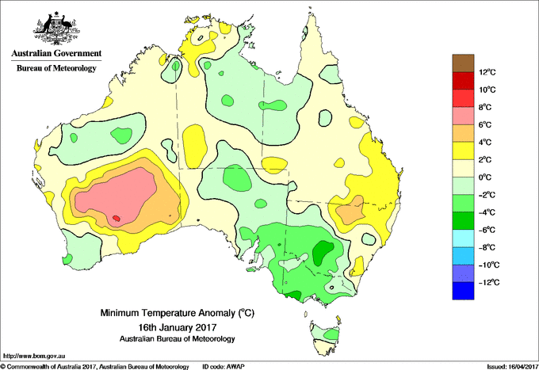
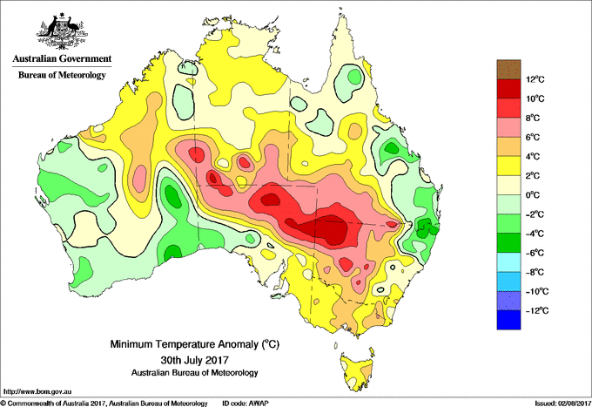
Correlation length scales not always uniform

Slide 12
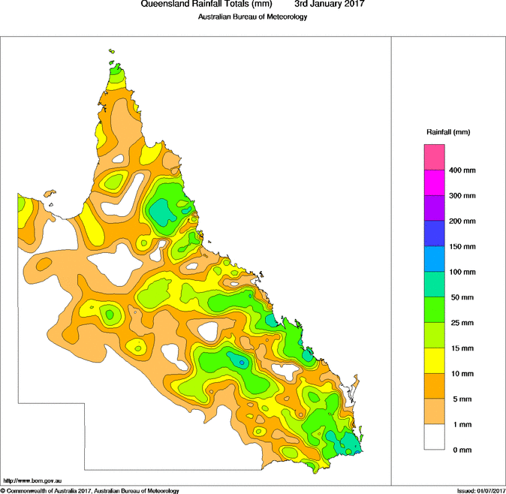
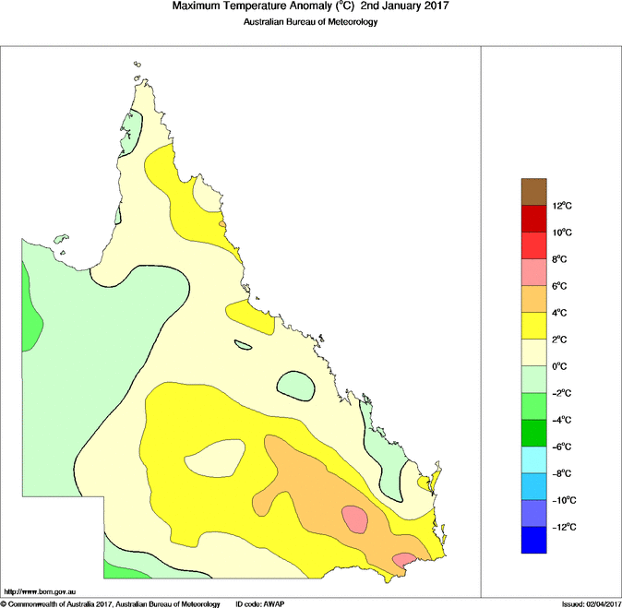
…and some elements have different length scales to others

Slide 13
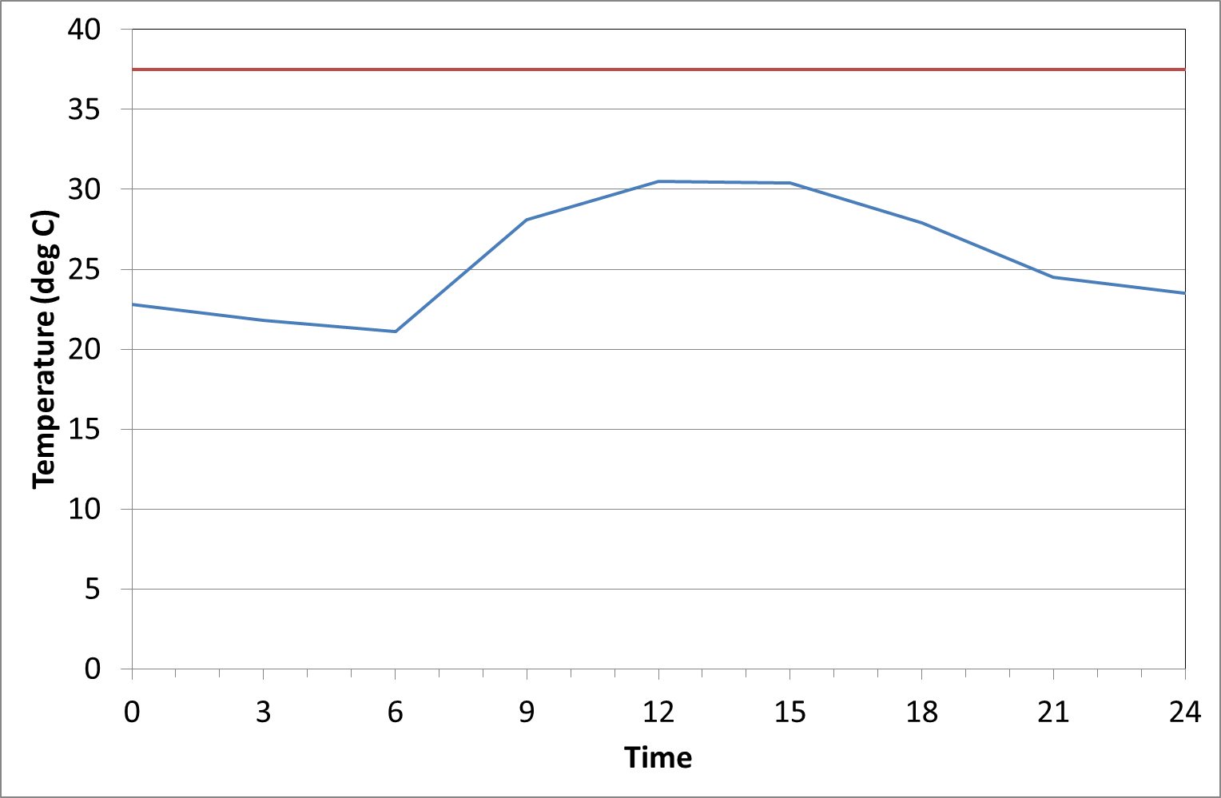
Greater temporal and spatial density of data helps QC
Carnarvon, 18 December 2008
Maximum
3-hourly temperature

Slide 14
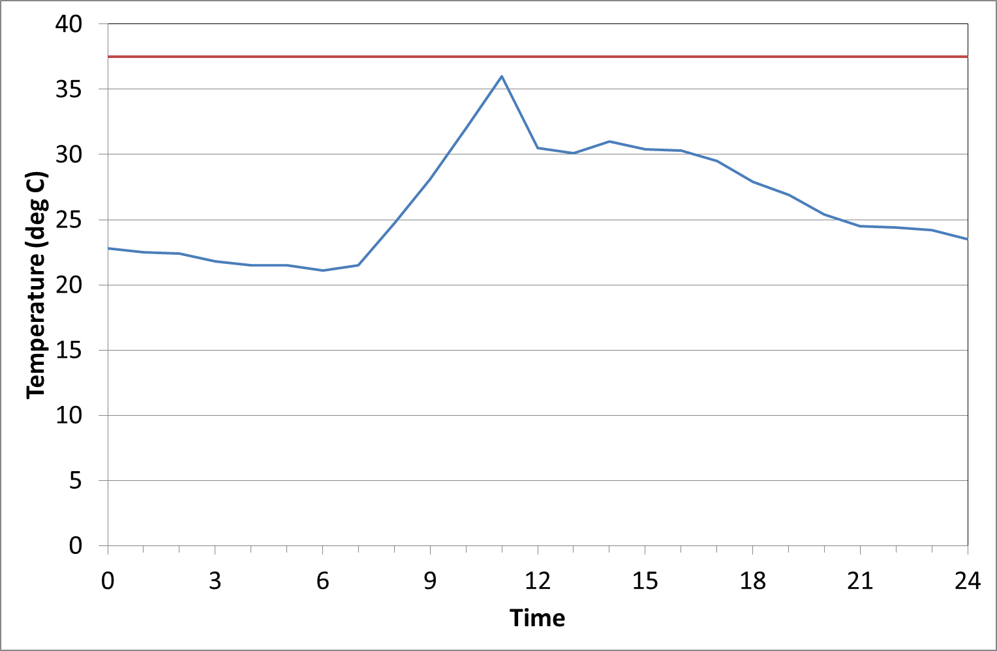
Greater temporal and spatial density of data helps QC
Carnarvon, 18 December 2008
Maximum
Maximum
3-hourly temperature
Hourly temperature
Seabreeze came in at about 11.30

Slide 15
Some things which can lead to sharp local gradients
Complex topography
Seabreezes (near coast)
Local winds
Thunderstorms
Fog

Slide 16
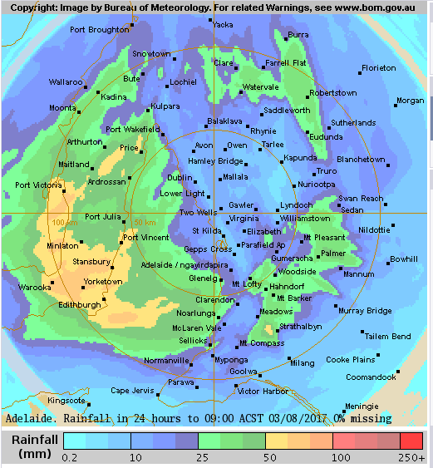
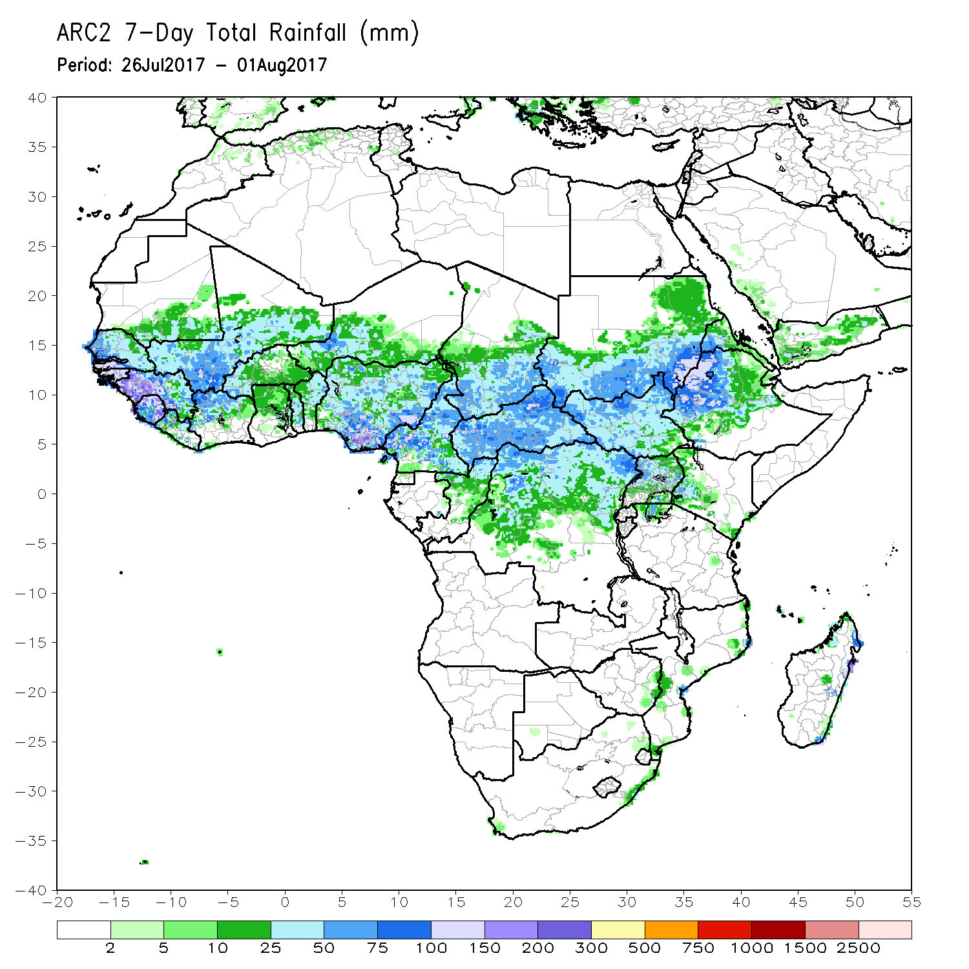
Remote sensing potential to be included in QC
Radar
Satellite
Radar is currently used as a secondary QC tool, but not a primary one

Slide 17
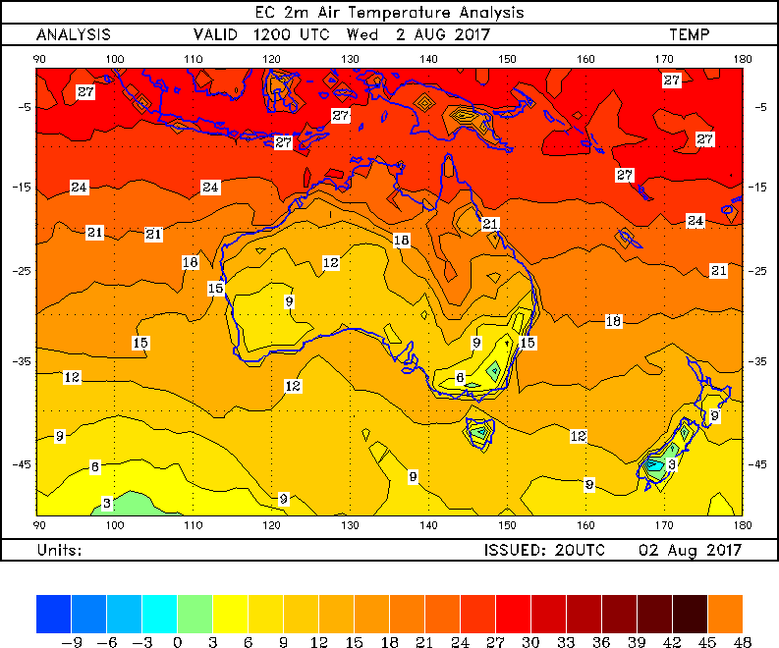
Possibilities to use forecast models in QC?
In modern weather forecasting models, analysis does not use observations alone – it uses observations to modify forecast field from last model run
Optimal combination of observed and model data a well-explored problem in forecasting, but climate applications limited
Could forecast/observation discrepancies be used for operational climate data QC?

